Slide 1
AIDI 1010 – Introduction to Emerging Technologies WEEK3(A)
Jahanzeb Abbas (JB)

Slide 2
Week Objectives
(A) AutoML
What? Who? Why?
What can be automated through AutoML?
(B) AutoML Deeper Dive
Pre-Modeling & Post-Modeling
Optimizing (or configuring) AutoML Hyperparameters
Reviewing Challenges, Risks, Benefits of AutoML
(C) Usage of AutoML (in industries)
(D) AutoML Libraries
(E) References

Slide 3


(A) AutoML (“Sales Pitch”)
If you were an organization – would you want a “crystal ball” that can (almost) help you predict what your customers want, or do next?
Wouldn’t you want to know what kind of behaviours your customers will have so that you know exactly where and how to invest within your company?
What if you didn’t have a plethora of resources or expertise (Data Scientists/Engineers) to review or cleanse your data, maintain a ML pipeline, or assess predictions at the same time?
This is where AutoML or AutoML software packages will comes into play..
OUTPUT, PREDICTIONS!
$$$$
INPUT

Slide 4
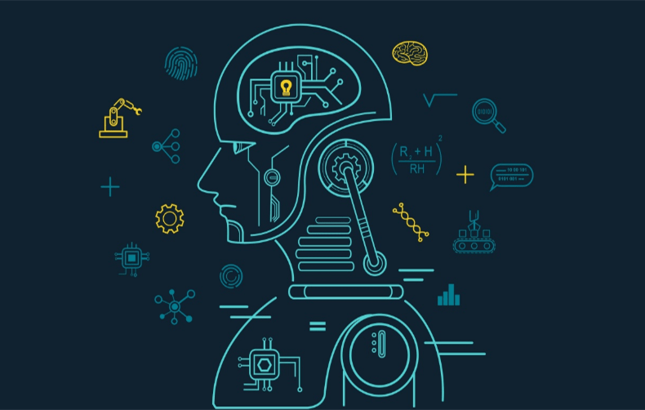
(A) AutoML (What is it?)
Automated machine learning (AutoML) is the process of automating tasks of applying machine learning to real-world problems. AutoML covers the complete pipeline from the raw dataset to the deployable machine learning model. AutoML was proposed as an artificial intelligence-based solution to the ever-growing challenge of applying machine learning. [Wikipedia]
AutoML is an attempt to easily build, use, and optimize steps to build machine learning models - that run systemic processes on data and select multiple models to pull most relevant detail about the raw data (pulling the signal in the noise)

Slide 5

(A) AutoML (Who is it for?)
The high degree of automation in AutoML allows non-experts to make use of machine learning models and techniques without requiring them to become experts in machine learning. [WikiPedia]
AutoML incorporates best ML practices from data scientists – to make ML readily available across an organization for non-ML experts (like business specialists), as well as to accelerate R&D using ML (like internal strategy & modeling teams)
Especially useful if there are aren’t any dedicated ML experts or resources in an organization

Slide 6
(A) AutoML (Why?)
Automating the process of applying machine learning end-to-end additionally offers the advantages of producing simpler solutions, faster creation of those solutions, and models that often outperform hand-designed models [WikiPedia]
AutoML aims to automate the below processes that typically require human ML experts (or data scientists):
Clean the data
Select the right features & model (family)
Optimize model Hyperparameters
Compare against alternative ML models
Analyze prediction results
AutoML packages provide a comprehensive set of configuration tools to fully customize such tasks

Slide 7
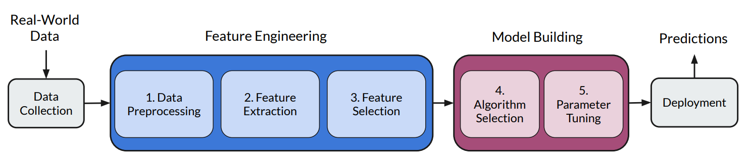
(A) Figure1
Automated Machine Learning: State-of-The-Art and Open Challenges (Fig1; Page2)

Slide 8
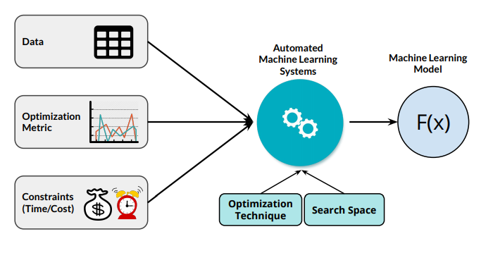
(A) Figure2
Automated Machine Learning: State-of-The-Art and Open Challenges (Fig2; Page2)

Slide 9
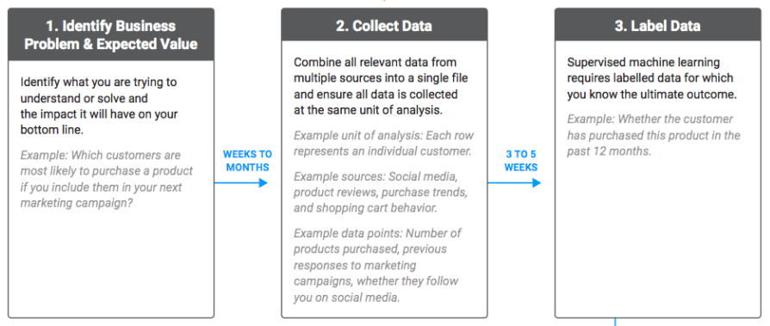
(A) Figure3
DataRobot – Standard Steps of Machine Learning with AutoML (1)

Slide 10

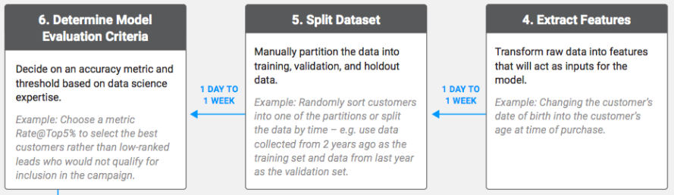

(A) Figure3
DataRobot – Standard Steps of Machine Learning with AutoML (2)

Slide 11
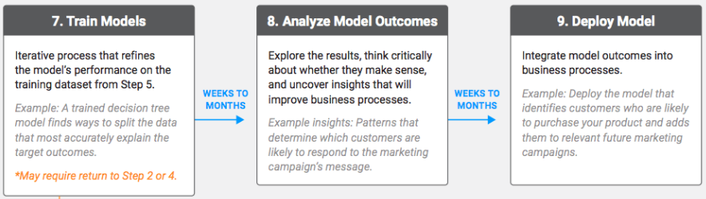
(A) Figure3
DataRobot – Standard Steps of Machine Learning with AutoML (3)

Slide 12
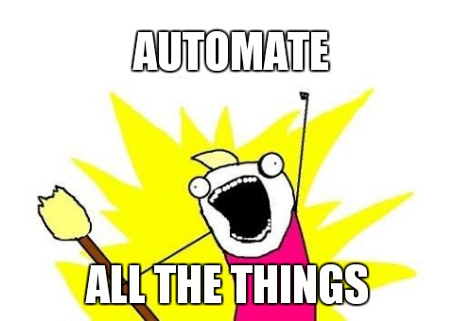
(A)

Slide 13
(A)

Slide 14
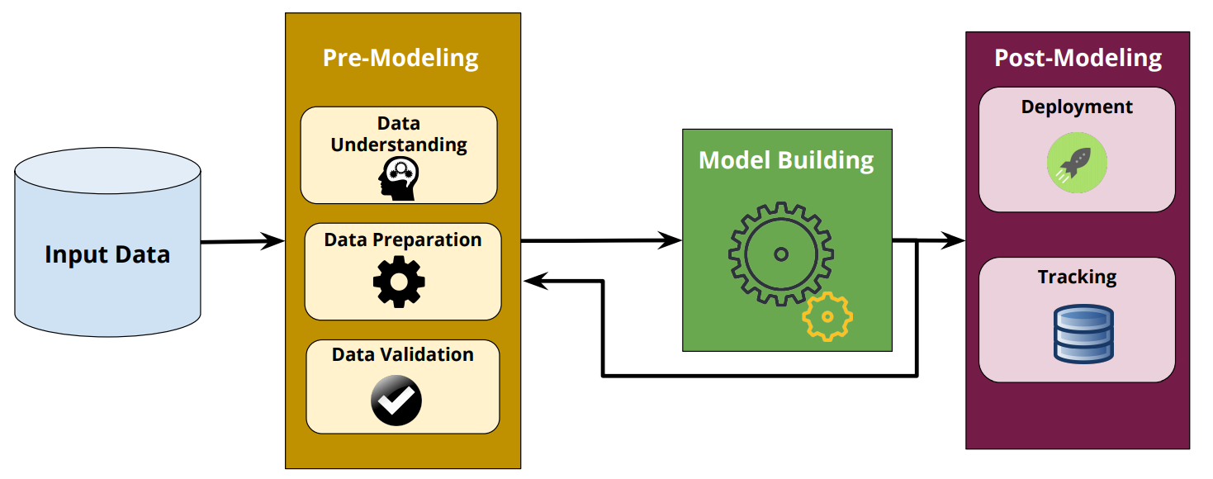
(B) AutoML: Humans are still needed!
Human intervention still plays a key role in two key steps; Pre-Modeling & Post-Modeling
Pre-Modeling – Data comprehension, preparation, cleanup, and validation (despite of tools: to confirm actions)
Post-Modeling – Management, tracking, & deployment of ML model; packaging up for production release & reproducibility
Automated Machine Learning: State-of-The-Art and Open Challenges (Fig 8)

Slide 15
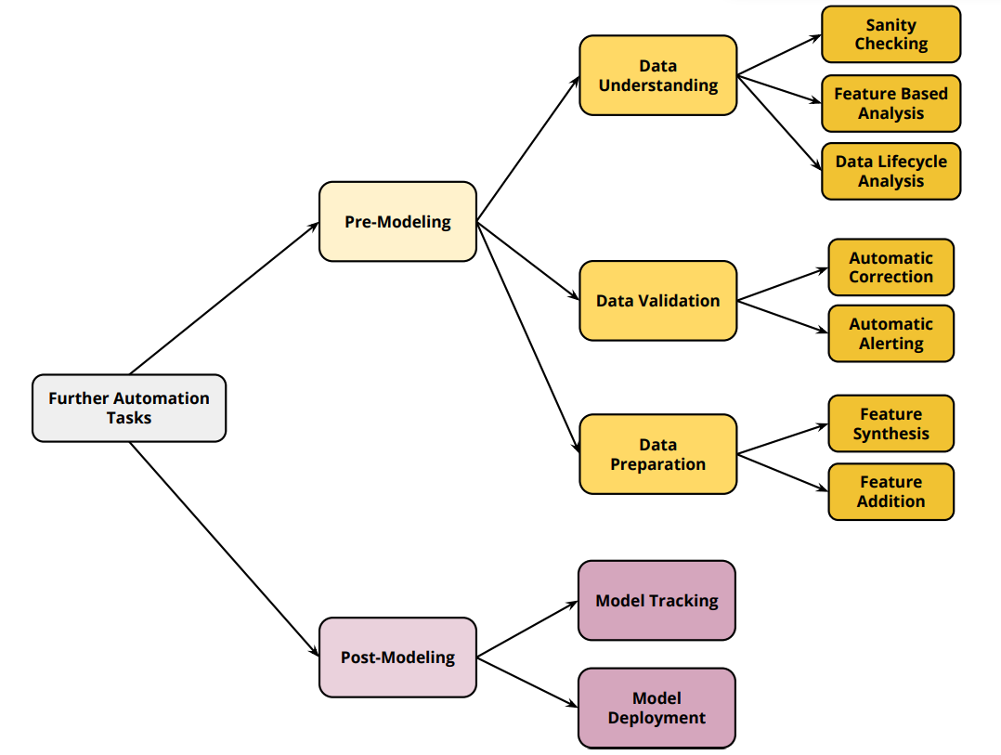
(B) AutoML: Humans are given assistance..
Automated Machine Learning: State-of-The-Art and Open Challenges (Fig 9)

Slide 16
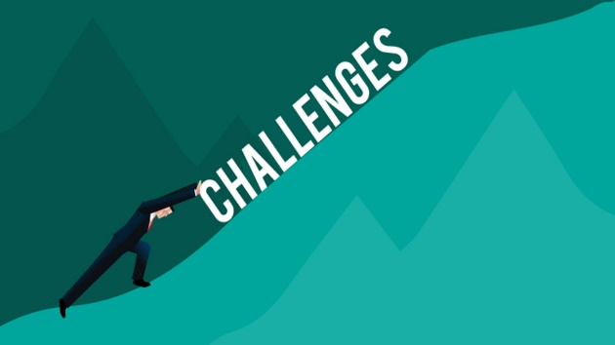
(B) AutoML: Challenges, Risks, Benefi
CHALLENGES
Research; Automating the process of Combined Algorithm Selection and Hyper-parameter tuning (CASH) in the machine learning domain. The goal is to find an internal algorithm that achieves the highest generalization performance by training and evaluating data. (Being reviewed constantly)
Data; high-quality data labels aren’t available, alongside data inconsistencies (real-time or batch). Making sense of unstructured and structured data. User-friendly interfaces are also a constant challenge.
Objectives; AutoML system optimizations are based on fixed objectives; ML models vs multi-layered objectives in a business (process). How to weigh in business factors (like cost-based decisions) within predictions.
Environments; AutoML is difficult in a dynamic environment vs a static environment. More complicated solutions need to be in place that are constantly learning and re-evaluating based on changing conditions.
Comprehension; Being able to explain the results as everyone has a different perspective. An approach would be to develop interpretation standards and follow an organizational level direction on results.

Slide 17
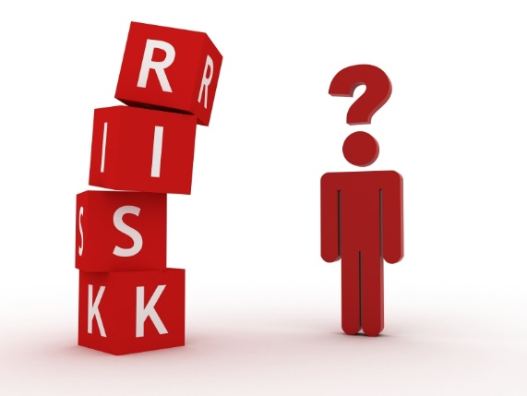
(B) AutoML: Benefits, Challenges, Risks
RISKS
Variable Searches and Noise; Automation of tasks can add rigor but cannot replace expert knowledge. Automation should be used as a complimentary tool to human experts. companies should opt for semi-automated model development process. Not all types of search for flu by everyone will provide the most accurate answers.
Data representation; as identified as a challenge in comprehension – the risk of data being represented incorrectly remains high. Every organization has its own depths of processes and procedures that could inversely impact interpretation of data.
Data-fitting; due to multiple inferences of either data or models – there’s a risk that data can lead to under or over-fitting. There can be other categories of data that could supplement predictions, instead of using similar data from a different industry. Example: Call Centers.
Security is a concern, AutoML lacks the support of laws, regulations and industry standards. Organizations need to promote the establishment and improvement of standards for federated learning and secure multi-party computing.

Slide 18
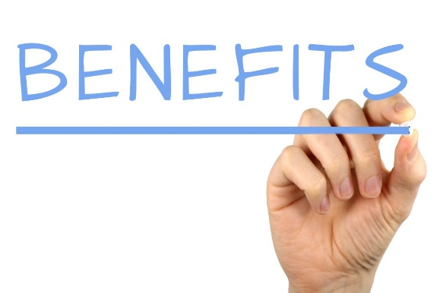
(B) AutoML: Benefits, Challenges, Risks
BENEFITS
Manually constructing a machine learning model is a multistep process that requires domain knowledge, mathematical expertise, and computer science skills – which is a lot to ask of one company, let alone one data scientist.
There are countless opportunities for human error and bias, which degrades model accuracy and devalues the insights you might get from the model.
Enables organizations to use the baked-in knowledge of data scientists without expending time and money to develop the capabilities themselves
Enables business users to implement machine learning solutions with ease, thereby allowing an organization’s data scientists to focus on more complex problems.
Increases productivity by automating repetitive tasks. This enables a data scientist to focus more on the problem rather than the models. Automating the ML pipeline also helps to avoid errors that might creep in manually.
Ultimately, AutoML is a step towards democratizing machine learning by making the power of ML accessible to everybody.

Slide 19
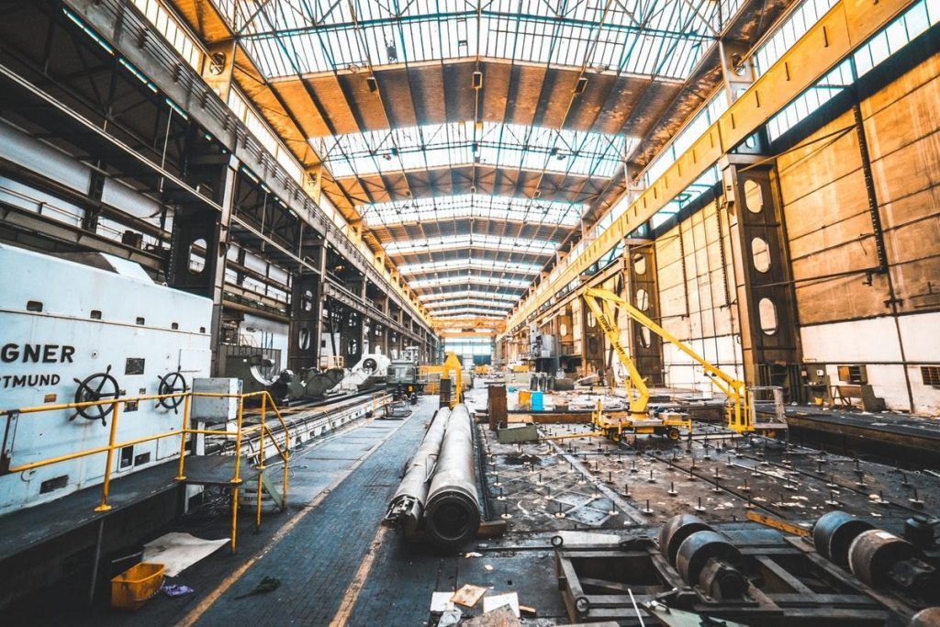
(C) Usage of AutoML (Industries)
Most companies are packaging ML solutions as a SaaS
Other companies can then hire these services who will deploy, guide, and maintain ML and even provide it as a SaaS; consultants will tune “algorithms” or tweak recipes or provide you with the toolkits to do so*
They will cook something with different heat levels (hyperparameters) with several ingredients (hyperparameter search)
They will look for the right proportions (different ratios) and come up with final dishes (predictions)
Other companies are bringing ML solutions with consultants to bridge the talent gap
Clients can outsource the talent who can help with ML deployment
Companies provide consulting services to build AI solutions that require ML experts or where technology doesn’t exist to automate any of the pieces
Couple of tasks are being automated by companies but majority of the solutions are through experts
Couple of other tasks like representing results with multiple models or deploying multiple models at once through a pipeline or delivery process (MLOps) -- on the back-end developers are all using AutoML libraries

Slide 20
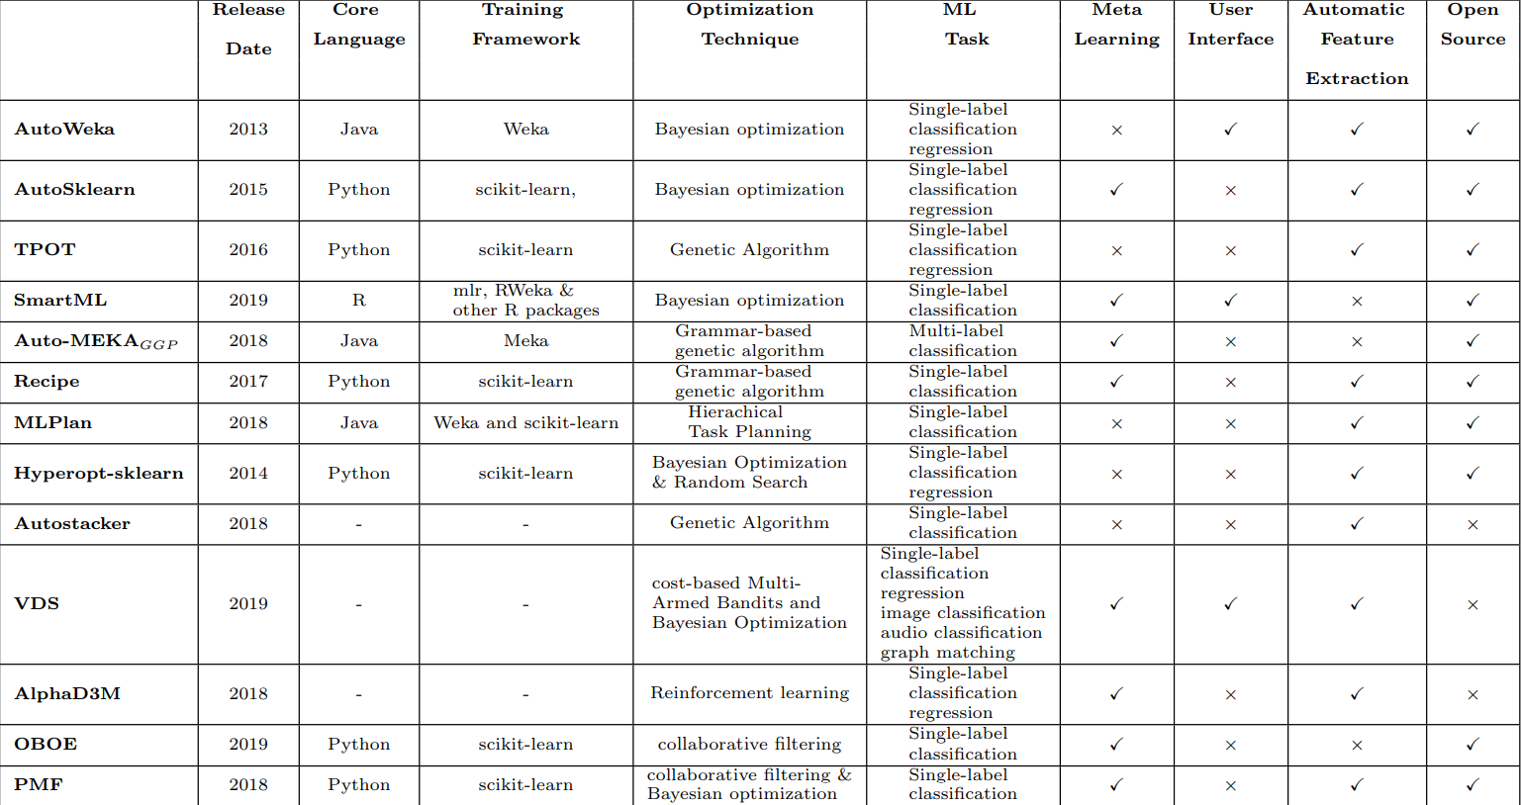
(D) AutoML (Libraries)
Below are some known libraries with their main features highlighted
Automated Machine Learning: State-of-The-Art and Open Challenges (Table 1)

Slide 21

(D) AutoML (Libraries)
Below are some known AutoML libraries
Auto-WEKA (Java) BayesOpt (C++) Featuretools auto-sklearn MLBox Xcessive TPOT Advisor Hyperopt Hyperopt-sklearn SMAC3 RoBo | BayesianOptimization Scikit-Optimize HyperBand Optunity ATM Cloud AutoML SigOpt DataRobot MLJAR MateLabs

Slide 22
Disclaimer
Due to nature of the course, various materials have been compiled from different open source resources with some moderation.
The course designer (slides creator), sincerely acknowledges their hard work and contribution, credit will be given wherever necessary

Slide 23
References
https://en.wikipedia.org/wiki/Automated_machine_learning
https://wiki.pathmind.com/automl-automated-machine-learning-ai
https://www.datarobot.com/wiki/automated-machine-learning/
https://www.automl.org/automl/
https://library.oapen.org/handle/20.500.12657/23012
https://arxiv.org/abs/1906.02287
https://docs.microsoft.com/en-us/azure/machine-learning/concept-automated-ml
What Are The Limitations Of AutoML? (analyticsindiamag.com)
AutoML: The Next Wave of Machine Learning | by Parul Pandey | Heartbeat (fritz.ai)
https://www.wired.com/story/googles-ai-experts-try-automate-themselves/
https://www.kdnuggets.com/2017/01/current-state-automated-machine-learning.html
https://aimultiple.com/automl-software

Slide 24

Thank You Very Much
Any Questions?

